Slide 1
Programming with Java/Python
Anan Yaagoub - PhD
Northwestern University

Slide 2
Week 4 - Agenda
Algorithms and Data Structure
  Hash Table
  Trees
Python and SQL DB
  mySql
Pandas
  Define
  SQL alike ++
  Analysis of US Baby Names

Slide 3
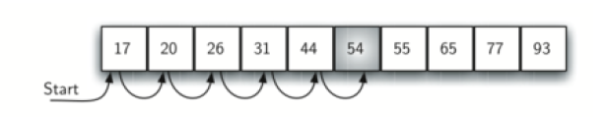
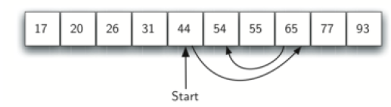
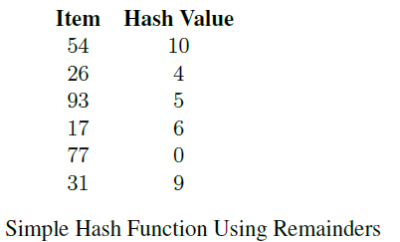
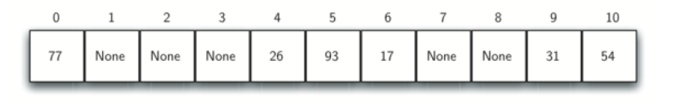
List - Search Algorithms
Sequential
Binary
Hash

Slide 4
What is Hashing
Data structure that can be searched in 𝑂(1)
A hash table is a collection of items which are stored in such a way as to make it easy to find them later.
Each position of the hash table is named by an integer value starting at 0.
Initially, the hash table contains no items.
We can implement a hash table by using a list of some size.
Each element initialized to the special Python value None.

Slide 5
Hash Function
The mapping between an item and the slot where that item belongs in the hash table is called the hash function.
The hash function will take any item in the collection and return an integer in the range of slot names, between 0 and 𝑚 − 1. (where m is the list size).
Ex: ℎ(item) = item%11. (modulo arithmetic)
load factor: 𝜆 = number_of_items / table_size.
For our example, 𝜆 = 6/11 .

Slide 6
Hash Function
perfect hash function: Given a collection of items, a hash function that maps each item into a unique slot.
Unfortunately, given an arbitrary collection of items, there is no systematic way to construct a perfect hash function.
Luckily, we do not need the hash function to be perfect to still gain performance efficiency.
Our goal is to create a hash function that:
  minimizes the number of collisions,
  is easy to compute,
  and evenly distributes the items in the hash table.
One way to always have a perfect hash function is to increase the size of the hash table (not always possible)
For example, if the items were nine-digit Social Security numbers, this method would require almost one billion slots. If we only want to store data for a class of 25 students, we will be wasting an enormous amount of memory.

Slide 7
Hash Function Techniques
folding method
  For example, if our item was the phone number 436-555-4601
  divide them into groups of 2 (43, 65, 55, 46, 01).
  addition, 43 + 65 + 55 + 46 + 01, we get 210.
  If we assume our hash table has 11 slots, then
    Hash(436-555-4601) = 210 % 11 = 1
mid-square method
  square the item, and then extract some portion of the resulting digits.
  For example, item 44
  compute 44**2 = 1,936.
  By extracting the middle two digits, 93, and
  performing the remainder step, we get 5 (93%11). how these values were computed.

Slide 8
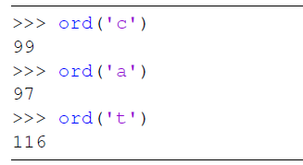
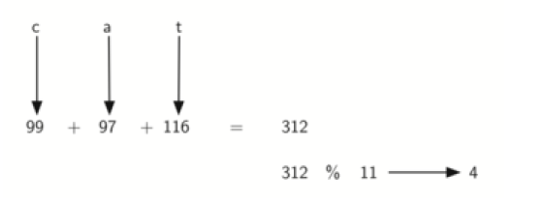
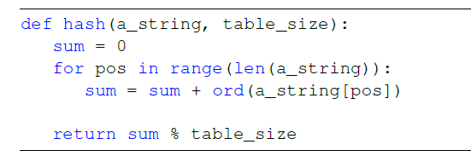
Hash Function - String
hash functions for character-based items such as strings.
  Map string to numbers using Ordinal value.
  Example: “cat”

Slide 9
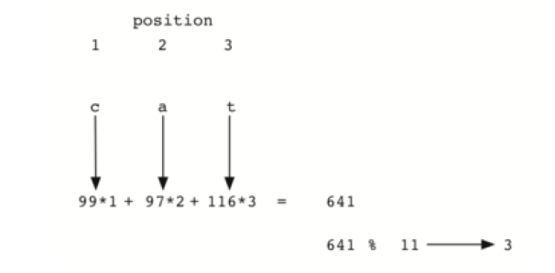
Hash Function - String
anagrams will always be given the same hash value.
To remedy this, we could use the position of each character as part of the calculation.

Slide 10
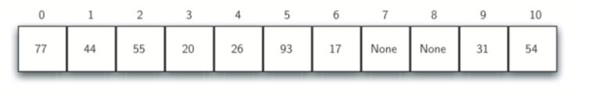
Collision Resolution
Collisions: When two items hash to the same slot.
Linear Probing: start at the original hash value position and then move in a sequential manner through the slots until we encounter the first slot that is empty.
Add 44,55,20
disadvantage to linear probing is the tendency for clustering

Slide 11
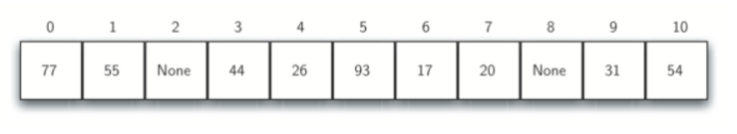
Collision Resolution
rehashing:
  With simple linear probing, the rehash function is
  new_hash_value = rehash(old_hash_value)
  where
    rehash(pos) = (pos + 1)%size_of_table.
  The “plus 3” rehash can be defined as
    Rehash(pos) = (pos + 3)%size_of_table.
  In general,
    rehash(pos) = (pos + skip)%sizeoftable.
Ex: add 44,55,20

Slide 12
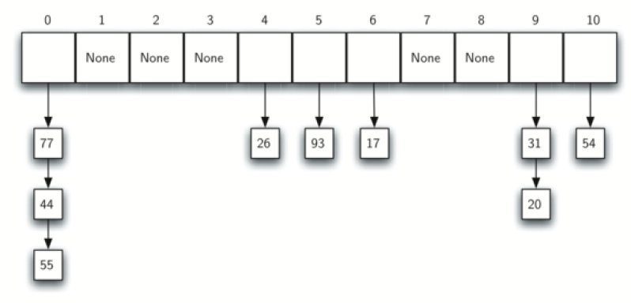
Collision Resolution
Chaining:
  allow each slot to hold a reference to a collection (or chain) of items.

Slide 13
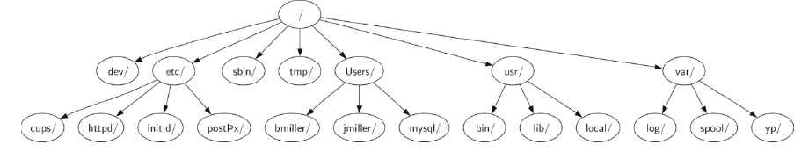
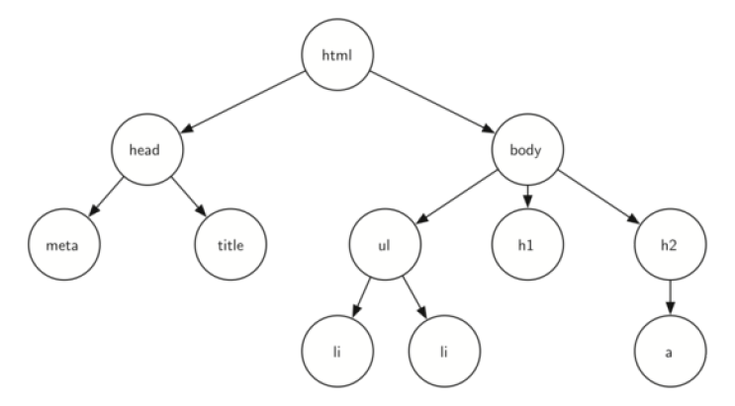
Tree Data Structure
Common data structure.
Trees are used in many areas of computer science:
  operating systems,
  Graphics
  database systems
  computer networking
File System
HTML document
Node
Edge
Root
Path
Children
Sibling
Subtree
Leaf Node
Level
Height

Slide 14
Binary Tree - Interface
Functions to create and manipulate a binary tree:
  BinaryTree() creates a new instance of a binary tree.
  get_left_child() returns the binary tree corresponding to the left child of the current node.
  get_right_child() returns the binary tree corresponding to the right child of the current node.
  set_root_val(val) stores the object in parameter val in the current node.
  get_root_val() returns the object stored in the current node.
  insert_left(val) creates a new binary tree and installs it as the left child of the current node.
  insert_right(val) creates a new binary tree and installs it as the right child of the current node.
Implementation techniques (Representation):
  list of lists
  nodes and references.

Slide 15
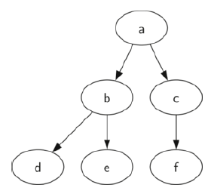
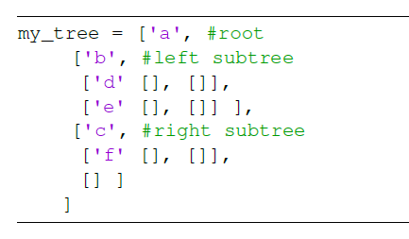
Binary Tree - List of Lists
Example
my_tree = [root,[left tree],[right_tree]]
root of the tree is my_tree[0]
left subtree of the root is my_tree[1]
right subtree is my_tree[2]
? my_tree[1][0]

Slide 16
Binary Tree -Nodes and References
Define a class that has attributes for:
  root value
  left subtrees.
  right subtrees.
Define the following functions of the class:
  __init__()
  BinaryTree()
  get_left_child
  get_right_child()
  set_root_val(val)
  get_root_val()
  insert_left(val)
  insert_right(val)

Slide 17
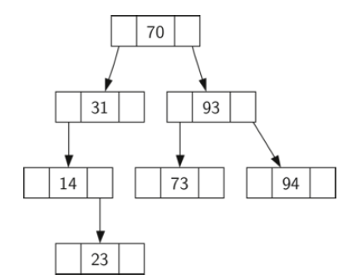
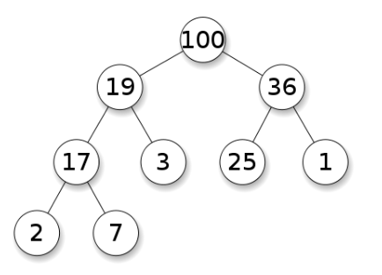
Binary Tree Applications
Binary Search Tree - Used in many search applications where data is constantly entering/leaving.
Heaps - Used in implementing efficient priority-queues, which in turn are used for scheduling processes in many operating systems, Quality-of-Service in routers, and A* (path-finding algorithm used in AI applications, including robotics and video games). Also used in heap-sort.
BST
HEAP

Slide 18
Binary Tree Applications
Hash Trees - used in p2p programs and specialized image-signatures in which a hash needs to be verified, but the whole file is not available.
Binary Space Partition - Used in almost every 3D video game to determine what objects need to be rendered.
Binary Tries - Used in almost every high-bandwidth router for storing router-tables.
Huffman Coding Tree (Chip Uni) - used in compression algorithms, such as those used by the .jpeg and .mp3 file-formats.
GGM Trees - Used in cryptographic applications to generate a tree of pseudo-random numbers.
Syntax Tree - Constructed by compilers and (implicitly) calculators to parse expressions.
Treap - Randomized data structure used in wireless networking and memory allocation.
T-tree - Though most databases use some form of B-tree to store data on the drive, databases which keep all (most) their data in memory often use T-trees to do so.

